Slide 1

PROJECT 1- SHARKS ATTACKS
PROJECT 1 -SHARKS ATTACKS

Slide 2
QUESTIONS TO BE ANSWERED:
ACTIVITY THAT THE PERSON WAS DOING
Activity with the highest attack rate
Activity with the highest mortality
Jinxed names ??
The worker of the 60’s 80’s and 2000’s
2

Slide 3

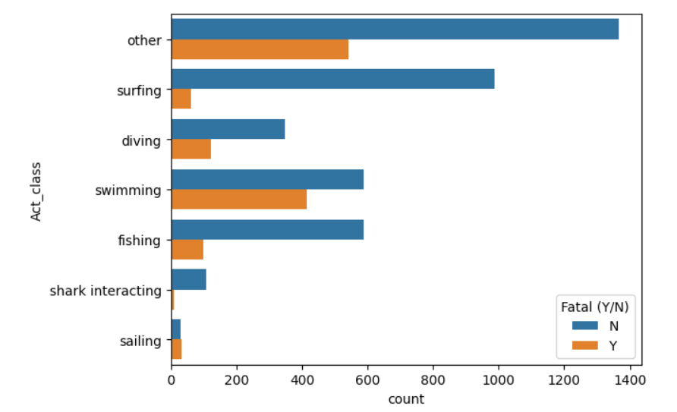
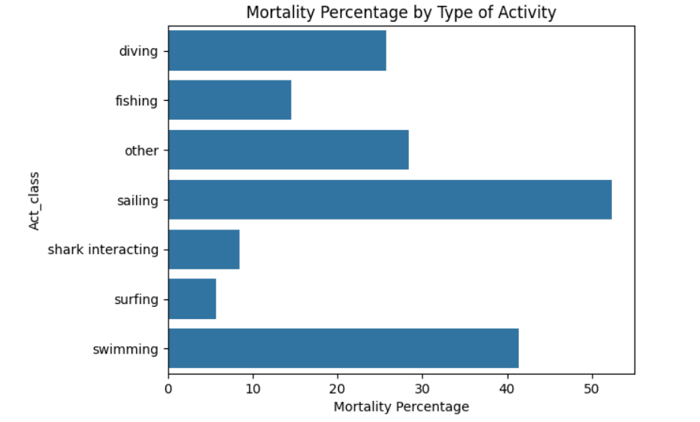
Activity with the highest attack rate
3

Slide 4
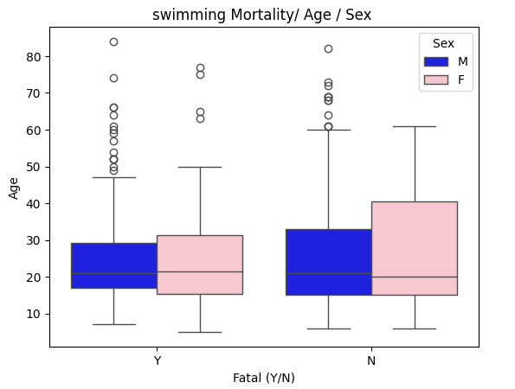
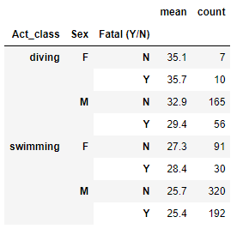
Is there a correlation between mortality and sex or age
4

Slide 5
Jinxed names??
NAME | Num. attacks
John | 112
William | 73
Robert | 72
James | 64
David | 52
NAME | Most attacked in.. | Freq. Attacked | Freq. Name in… | Jinx
John | USA | 2,81 | 3,27% | no
William | USA | 2,44 | 0,88 % | Yes
Robert | USA | 2,94 | 1,4 % | Yes
James | USA | 1,94 | 1,6 % | Yes
David | USA | 1,56 | 1,5 % | In the borderline
Name your son with a very popular name to minimize he/she shark’s attack probability

Slide 6
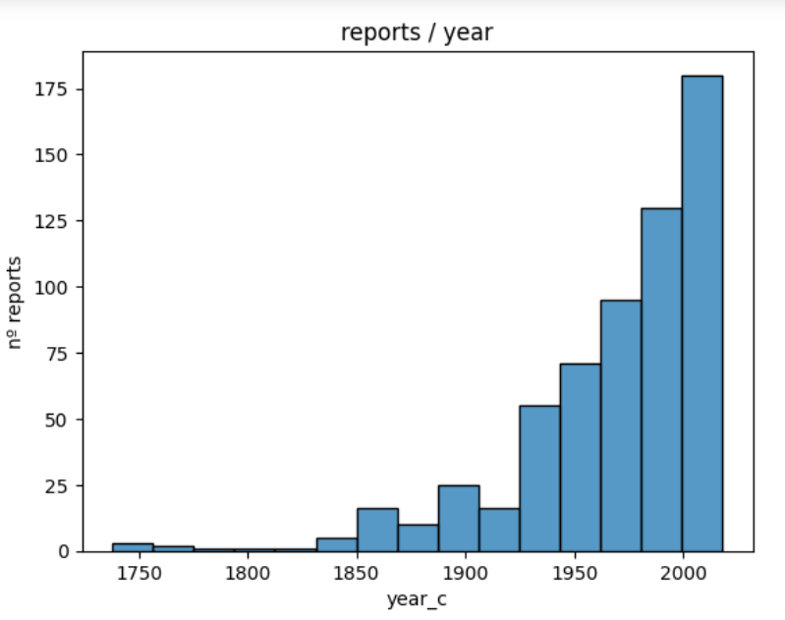

Let’s see who workded the most
/ 20 years

Slide 7
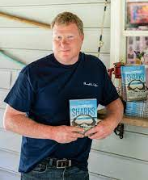
FROM 1960 UNTIL 1969 FROM 1980 UNTIL 1999
M. Levine, GSAF - 10 rep A. Gifford, GSAF - 8 rep
Marie Levine Albert Andrew Gifford - Shark Research
Head of the Shark Research Institute in Princeton Institute died in 2003
FROM 1960 UNTIL 1969
C. Creswell, GSAF - 17rep

